Slide 1

AVIATION RISK ANALYSIS
Goal: Help the company identify low-risk aircraft for commercial/private operations.

Slide 2
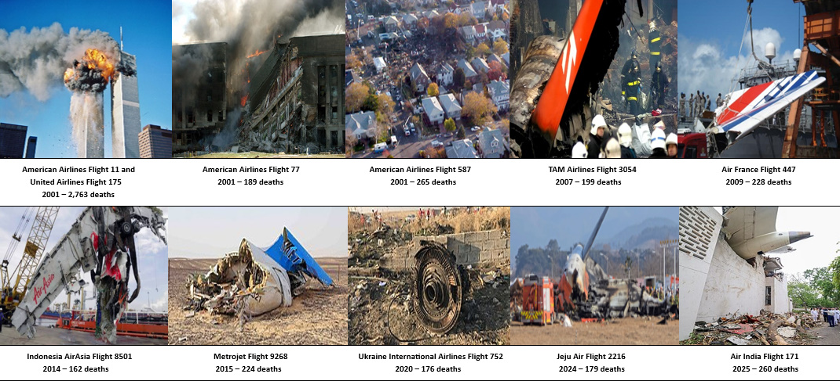
Aviation Risk Analysis for Aircraft Acquisition Insights from U.S. Accident Data (up to 2023)
This Photo by Unknown Author is licensed under CC BY-SA

Slide 3
Business Problem and Objective
A company is looking to Expand in Aviation Operations
There is need for analyzing and identifying the low-risk aircrfats for purchase
We need to identify , Which aircraft types and categories report the lowest risks and casualties
DATA SOURCE : https://www.kaggle.com/datasets/khsamaha/aviation-accident-database-synopses
Aviation accidents Database and Synopses

Slide 4
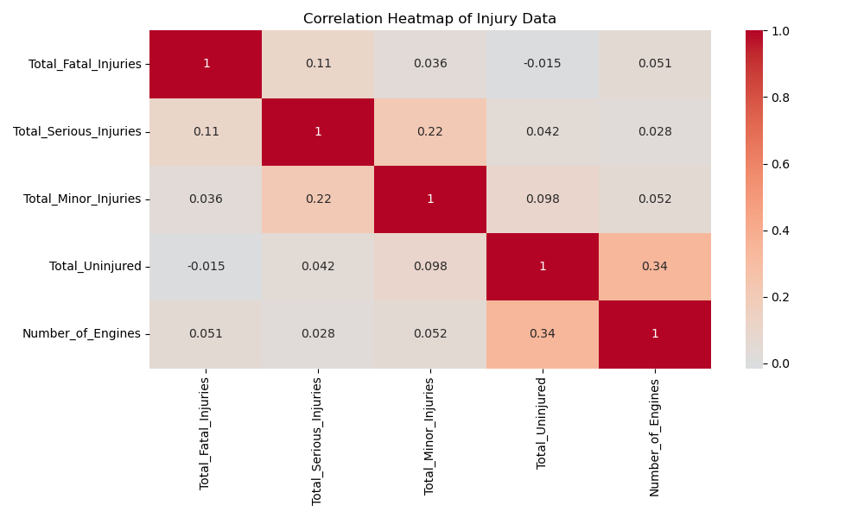
Numeric column relationshio

Slide 5
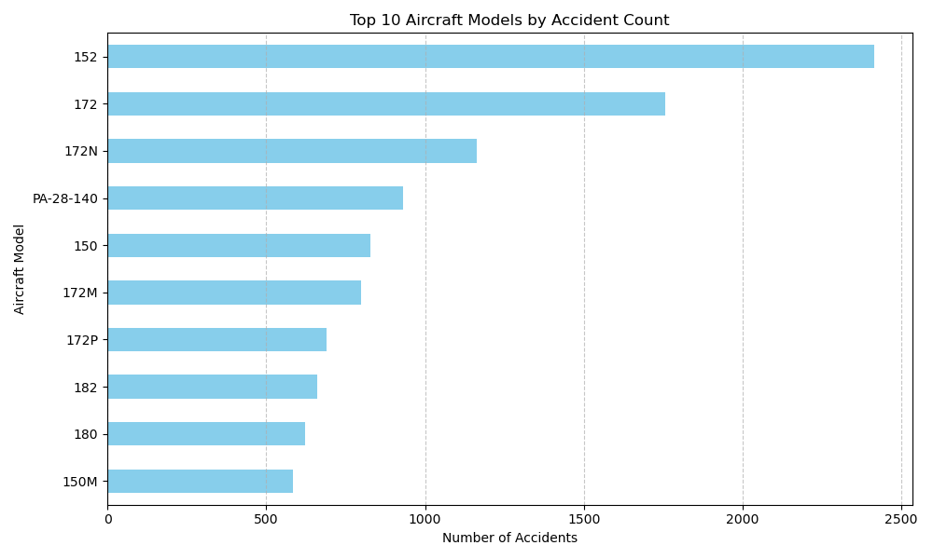
Aircraft Category by Accident counts
From the observation , the following are the most Aircraft categories with high number of accident counts .
152 Category has the highest frequency , followed closely by 172 and 172N respectively
Ones with the lowest frequency are MMB-BK117-B2

Slide 6
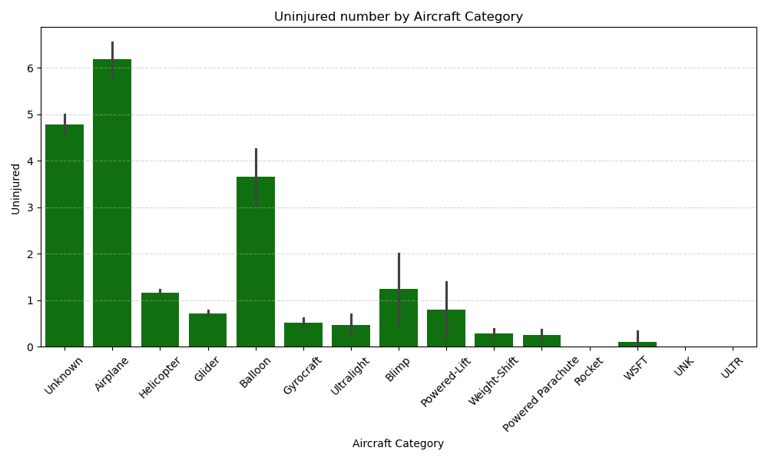
What are the Average fatalities by Aircraft categories

Slide 7
Average Fatalities By Aircraft Category
WSFT has the least number of uninjured passengers .
Airplanes and Helicopter tend to pose high risk

Slide 8
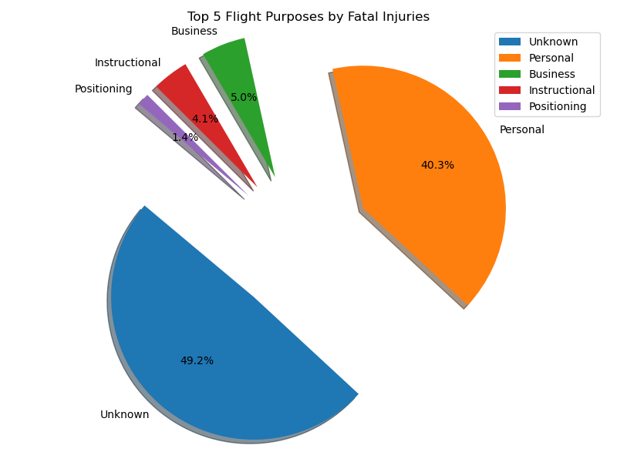
Fatal Injuries By Purpose of Flight
Personal Flights report high number of fatal cases in Aviation accident cases
Business flights tend to experience a lower percent of fatal cases in aviation accidents

Slide 9
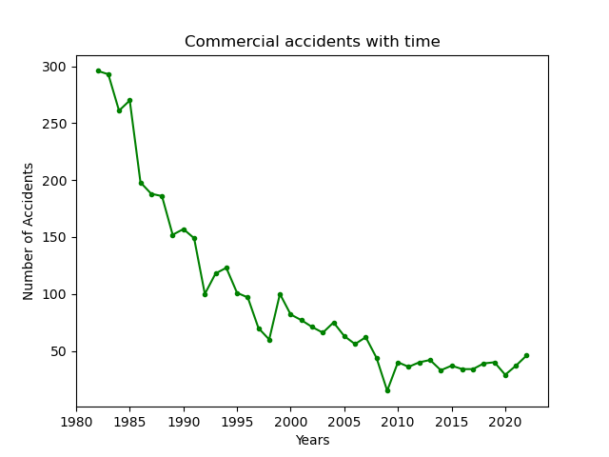
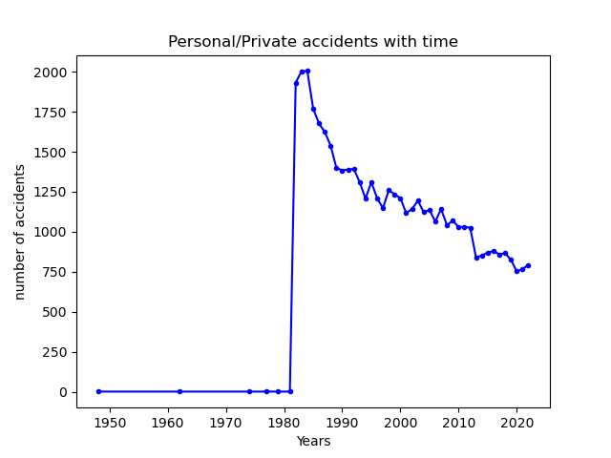
The Trend of accidents with time
Commercial Aviation flights are significantly reporting low accident frequencies
Personal/private flights spiked in the year 1980 and began to steadily fall in frequency .

Slide 10
Key Observations
1.Aicrafts with a single number pose higher risks of aviation accidents . Those with 8 engines pose less risk .
Reciprocating engine type records high number of aviation accidents .
It is also responsible for high casualties reported
3. Aviation accidents are declining with time . Commercial flights are significantly reporting lower cases , followed by business flights
4. UNK engine type records minimal accident counts and less fatal cases reports

Slide 11
Recommendations
Invest in Commercial flights , they are less prone to aviation accidents
Purchase flights with UNK engine type as it is less prone to accidents and records low number of fatalities accident cases
SNJ-5C , QUICKSILVER SPORT 2 , 727-2Q8, WMF, and M-8-EAGLE are the ideal Aircraft models
Flights with high engine numbers are safer compared to with less number of engines¶

Slide 12
THANK YOU :
Lawrence Kamerino
Linkedin
More visuals at : Phase 1 project | Tableau Public

